Slide 1

Ethical Hacking
Fighting fire with fire

Slide 2
What is ethical hacking?
- What is hacking and it’s intent?
- What determines if a person is a hacker?
- What is ethical hacking?
- In what ways can hackers gain unauthorized access into system?
- common Tools used by Malicious Hackers
- ethical hacking and How it plays a role in combating unauthorized access by malicious hackers?
- some key vulnerabilities do ethical hackers look for
- common Tools that most ethical hackers Use and the steps Take to secure a system
Notes:
What is ethical hacking? I’m sure for many this oxymoron has confused many people and has been the topic of many interesting conversations. In an attempt to help to clarify any questions about ethical hacking, we will work to explain what hacking is and its intent, what determines if a person is hacker, what ethical hacking is, the ways hackers obtain unauthorized access, common tools used by malicious hackers, ethical hacking and it role in combating threats, key vulnerabilities ethical hackers look for, and common tools, used by most ethical hackers.

Slide 3

Some of the most common Tools used by Malicious Hackers
Malware
Viruses
Phishing
Spoofing
Logic bombs
Ransomware
Etc..
This Photo by Unknown Author is licensed under CC BY-SA
Notes:
Attackers often use many different tactics to exploit, damage, and steel, information or money from unexpecting victims. The attacks can come in the form of malware, viruses, worms, trojans, phishing and spoofing, hoaxes, social engineering, logic bombs, DDoS attacks, and ransomware to name a few. Because there a plethora of attacks, it is very important ethical hackers are aware of these types of attacks in order to identify and combat them.

Slide 4

What is Hacking and its intent?
The Hacker’s Mind
The purpose
Who can be a hacker?
Types of Hackers
(Zampanti, 2019)
Image by: Unknow author 11/29/2021
Notes:
Often times we believe hacking to be only associated with the use of technology, but the truth is hacking has been around for longer than we know. Our perception of what hacking is has primarily been shaped by our awareness of system breaches and social media account hacks. But hacking can also be done in ways that require no use of technology, but merely by asking a series of questions to obtain the necessary information needed to gain unauthorized access. We know this as social engineering. Other forms of hacking includes the age old trick of breaking the combination on the old style MasterLock combination locks, or merely jimmying a door to gain access to a facility or a room.

Slide 5
The purpose
Government Systems
Energy Infrastructure
Vulnerability Exploitation
Financial institutions or Individuals
Monetary Gain
Exposing Celebrity Accounts
Corporations
Thrill Seeking
Notes:
Though the desire to gain unauthorized access to a system or facility is the goal, often time the purpose behind hacking is monetary, to exploit a system’s vulnerabilities, and or for sheer thrill seeking. This purpose can be target towards an individual, a company, or a government.

Slide 6


Who can be a hacker?
Can we be sure?
Potential hackers often do not look like we think
This Photo by Unknown Author is licensed under CC BY-NC
This Photo by Unknown Author is licensed under CC BY-SA
Notes:
The truth is that we can’t truly know or determine who is a hacker. Hackers can be young intuitive children just looking for a thrill, or an older person who has years of knowledge in computer science and coding, or a hacker could be a man or woman, can be a nation state, or even a computer, or a network of computers. Hackers a

Slide 7

Types of Hackers
Black Hat
Gray Hat
White Hat
State-sponsored
Red Teams
Blue Teams
(Zampanti, 2019)
Image by: Unknow author 11/29/2021
Notes:
In order to understand ethical hacking, we first must understand that there are different types of hackers. From the black hat hackers that are malicious and seek to do harm, to the gray hat hackers that look for vulnerabilities in systems, software, and devices and publish the finding to force companies into fixing them, whit hat hackers that participate in breaching systems for ethical reasons, state-spored hackers, which could be a group or individuals employed by a nation to hack other nations, red teams which is a group of ethical hackers masking as malicious attacker to gain intel on how to combat them; and lastly, blue teams, which is a group of ethical hackers that work closely with red teams in or to secure and fortify systems from malicious attacks.

Slide 8
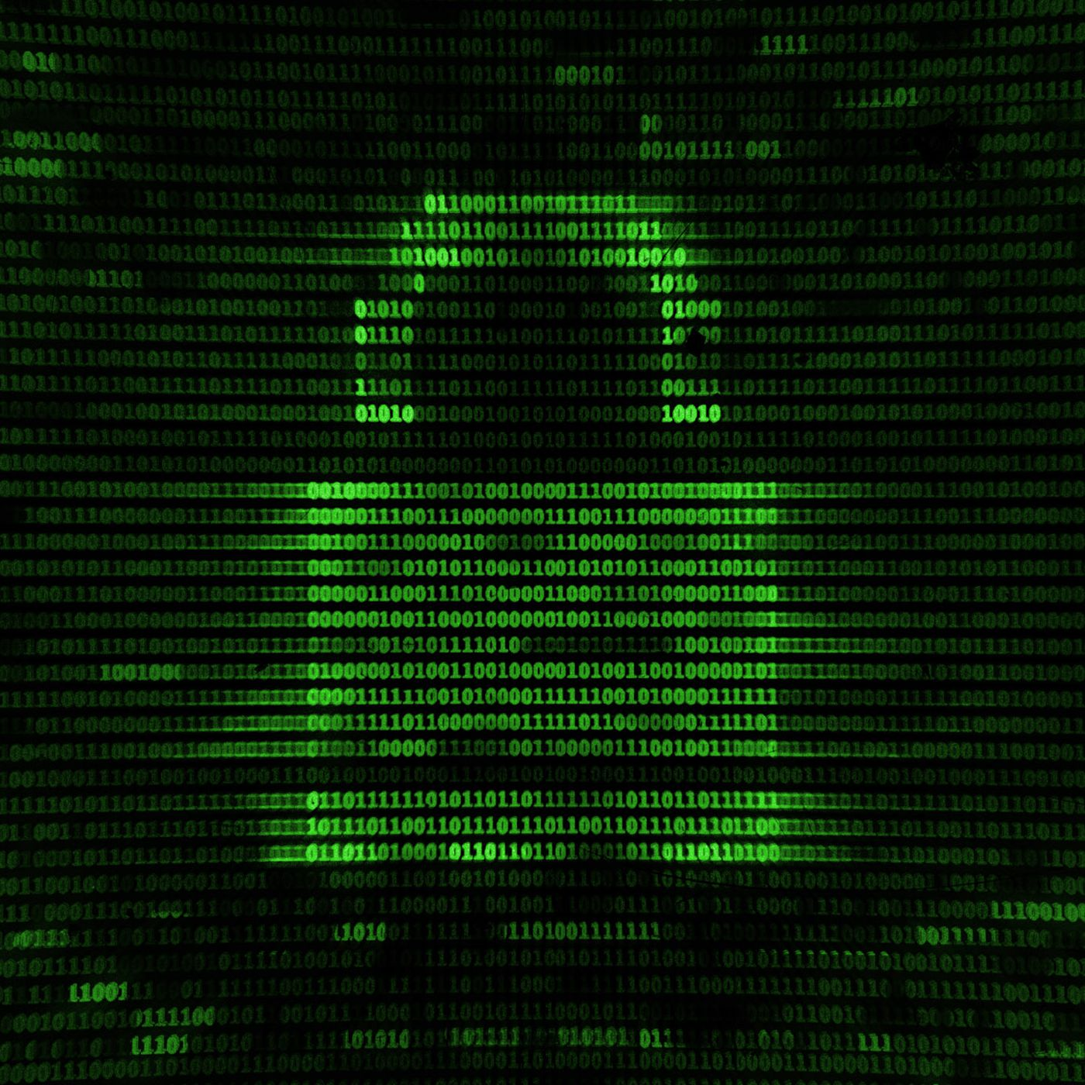
In what ways can hackers gain unauthorized access into system?
Image by: Unknow author 11/29/2021
(Mark Ciampa, 2014)
Notes:
Hackers can gain unauthorized access to systems in many ways. Some of these ways includes social engineering, trojan horses and back doors downloaded to systems through the exploitation of a program vulnerability, through metadata hidden within clickable images on a nefarious website, just to name a few.

Slide 9
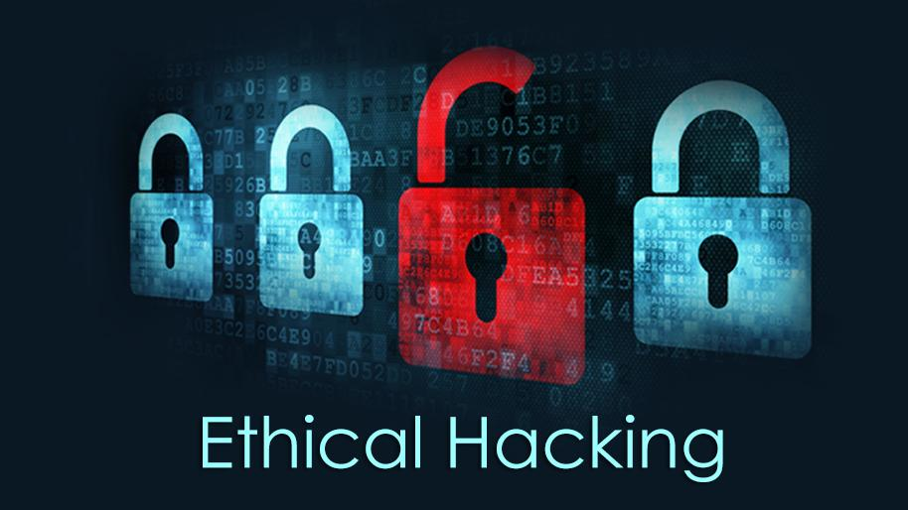
Ethical hacking and how it plays a role in combating unauthorized access by malicious hackers?
This Photo by Unknown Author is licensed under CC BY-SA-NC
(Simplilearn, 2021)
Notes:
We can view ethical hacking as the legal authorization to bypass system securities with the intent to detect, analyze, secure vulnerabilities found in a system or its network. Ethical hacking is a legal practice employed by companies who wants to insure their systems are secure from potential attacks. An ethical hacker could be an individual contractor, or it could be a team of hackers, such as a red team or a blue team as mentioned earlier.

Slide 10
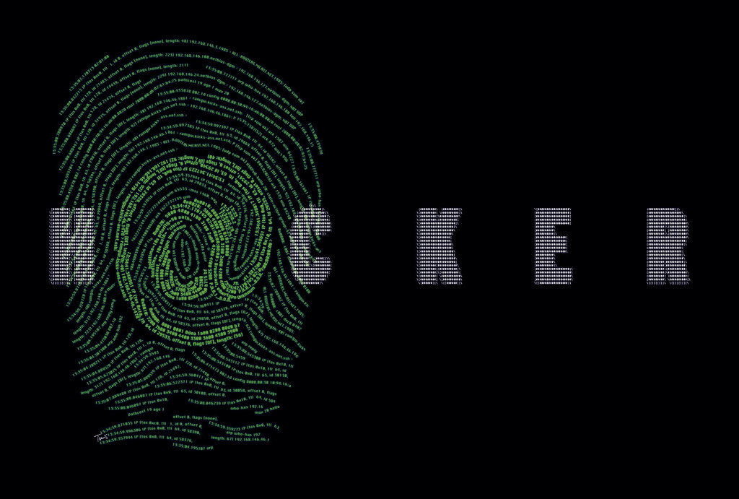
Ethical Hacking Cont’d
White Hat Hackers
Red Hat Hackers
Blue Hat Hackers
(Sarangam, 2020)
This Photo by Unknown Author is licensed under CC BY-NC-ND
Notes:
Differing from malicious hackers, ethical hackers can either White Hat hackers, red hat hackers, or blue hat hackers. In detail, a white hat hacker are often employed by a company and can be security professionals. This type of hacker often work with other security professionals to legally hack the systems of an authorized owner. This type of ethical hacking is used improve system protocols and network, amongst other things. Much like the White Hat hacker, Red Hat hackers too, operate ethically but often use aggressive counter-measure that can lead the total destruction of the systems of Black Hat hackers. Of times these types of hackers are employed by the government. And lastly, Blue Hat hackers, are too considered to use ethical hacking in their approach to finding vulnerabilities, is also believed to be individual who have little to no skills, or interest in hacking, but have desire to seek revenge against a hacking that may have caused him or her destress.

Slide 11
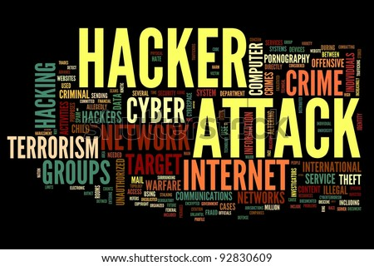
Key vulnerabilities ethical hackers look for
Injection attacks
Changes in security settings
Exposure of sensitive data
Breach in authentication protocols
Components used in the system or network that may be used as access points
(Simplilearn, 2021)
This Photo by Unknown Author is licensed under CC BY
Notes:
In an effort to protect systems and networks, ethical hacking would necessarily require the security professionals to look for vulnerabilities such as, SQL injections, changes in security settings, unprotected databases which may expose sensitive data, weakness in middleware security, and risks within protocols used to transmit data.

Slide 12
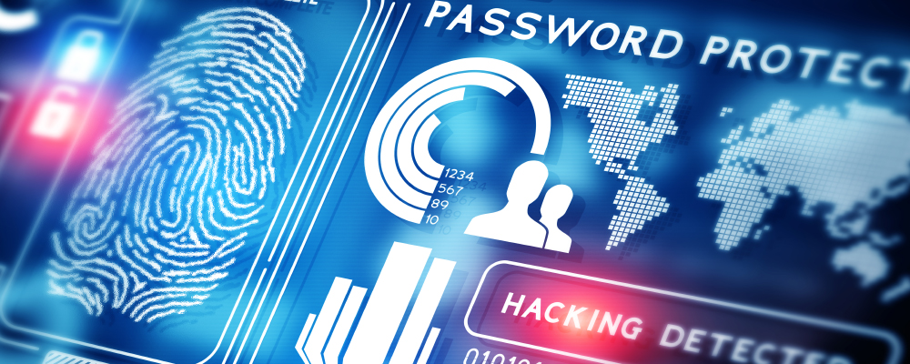
Common tools most ethical hackers use and the steps taken to secure a system?
John the Ripper
Metasploit
Nmap
Wireshark
OpenVAS
IronWASP
Nikto
SQLMap
SQLNinja
Maltego
Burp Suite
NetStumbler
AirCrack-ng
Ettercap
Canvas
This Photo by Unknown Author is licensed under CC BY
(Team, 2021)
Notes:
In combating cybersecurity threats, some the most common tools ethical hackers use are well known computer specialist around the world. From Nmap, which is a free open source security tool used by many infosec professional to manage and audit networks and Operating Systems, for both local and remote devices, Wireshark, which is also a free open source tool that allows you to real-time analysis of network traffic, to John the Ripper, which is consider the most popular for cracking passwords and building password security. John the Ripper, is famed or being able to detect which type of encryption is used to secure a password and decrypt it. These tools are only few considered to fall within the top 15 tools used by infosec professionals.

Slide 13
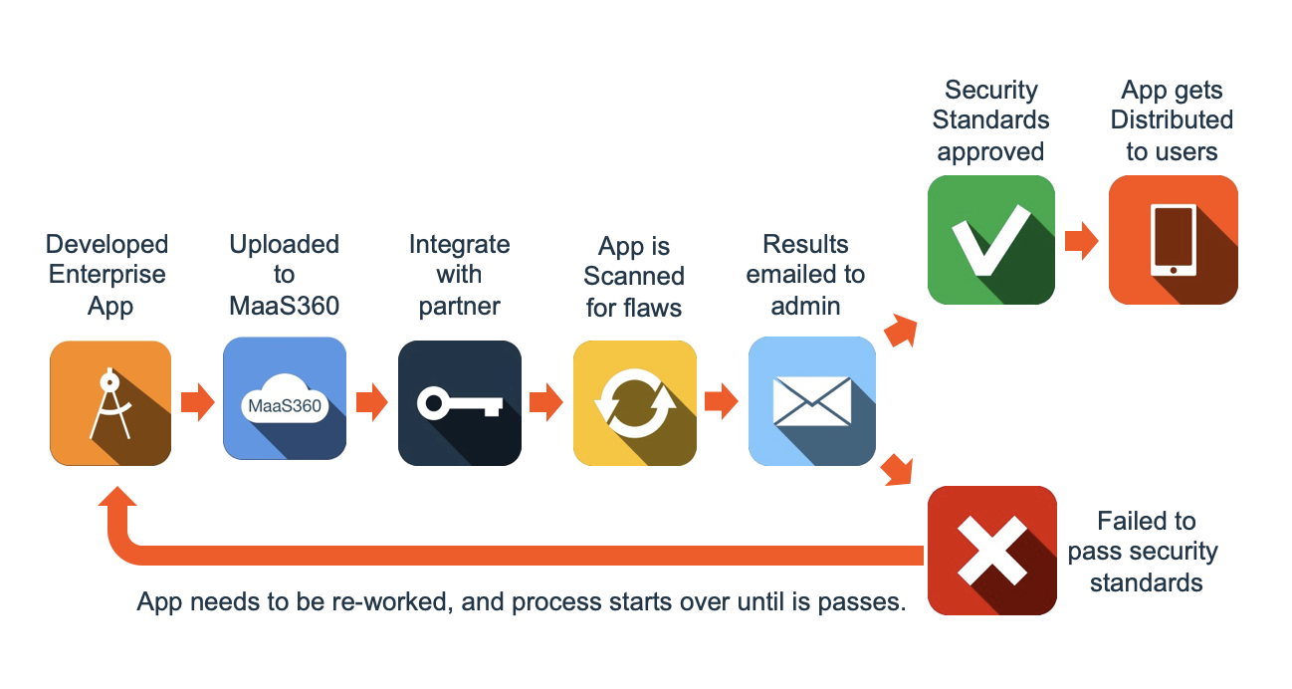
Conclusion
This Photo by Unknown Author is licensed under CC BY-SA
Notes:
In an attempt to insure that system and networks are secured properly, it will require multiple resources from development to distribution to look for any possible vulnerabilities that can result in breaches. But, the pursuit of adequate security does not end there. Developers, companies, and governments, must work continuously to find possible susceptibilities to malicious hackers. In that pursuit, the employment of ethical hackers is essential to this success. There ethical hacking today, and in the foreseeable future, is a vital role to secure our systems, networks, and the precious data we have.

